Slide 1
Structural Relationships
Presenter: Nguyễn Hải Đăng

Slide 2
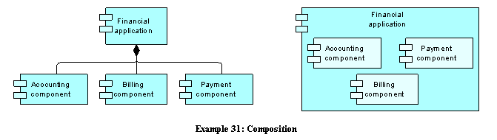
Composition Relationship
The composition relationship indicates that an object consists of a number of other objects.

Slide 3
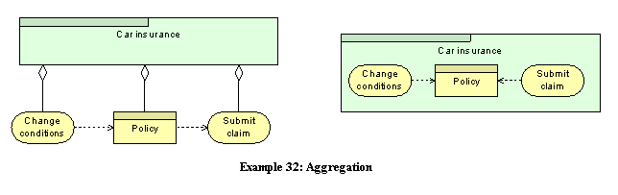
Aggregation Relationship:
The aggregation relationship indicates that a concept groups a number of other concepts.

Slide 4
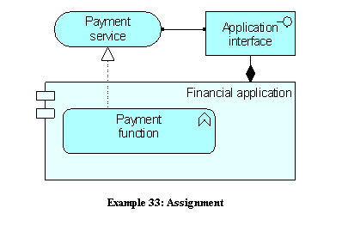
Assignment Relationship
The assignment relationship links active elements (e.g., business roles or application components) with units of behavior that are performed by them, or business actors with business roles that are fulfilled by them.

Slide 5
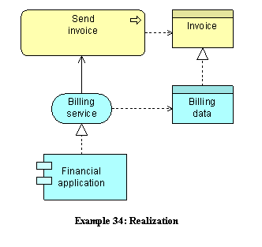
Realization Relationship
The realization relationship links a logical entity with a more concrete entity that realizes it.

Slide 6
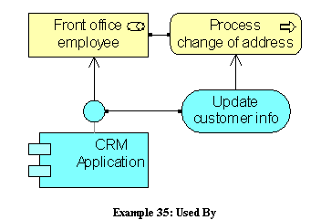
Used By Relationship
The used by relationship models the use of services by processes, functions, or interactions and the access to interfaces by roles, components, or collaborations.

Slide 7
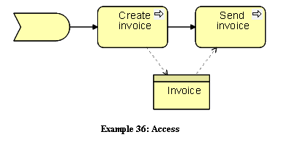
Access Relationship
The access relationship models the access of behavioral concepts to business or data objects.

Slide 8
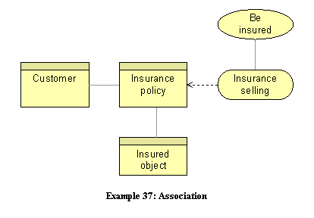
Association Relationship
An association models a relationship between objects that is not covered by another, more specific relationship.

Slide 9
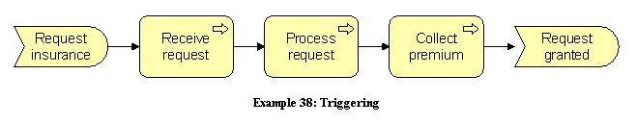
Dynamic Relationships
Triggering Relationship
The triggering relationship describes the temporal or causal relations between processes, functions, interactions, and events

Slide 10
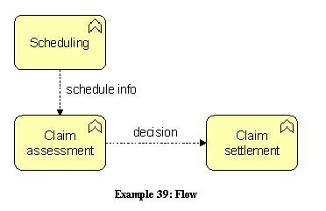
Flow Relationship
The flow relationship describes the exchange or transfer of, for example, information or value between processes, function, interactions, and events.

Slide 11
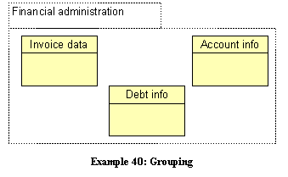
Other Relationships
Grouping:
The grouping relationship indicates that objects belong together based on some common characteristic.

Slide 12
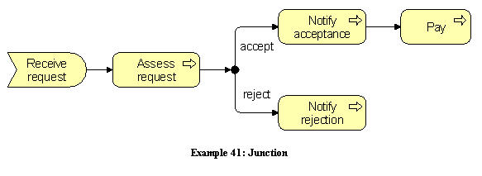
Junction
A junction is used to connect dynamic relationships of the same type.

Slide 13
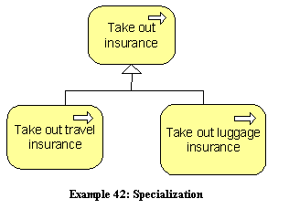
Specialization Relationship
The specialization relationship indicates that an object is a specialization of another object.

